Slide 1


SAP
Material Management Overview
08.02.2023

Slide 2
SAP MM Overview
SAP Overview
SAP stands for Systems, Applications and Products in Data Processing.
ERP - Enterprise Resource Planning
• Organizations can easily fulfill their business requirements

Slide 3
SAP MM Overview
SAP MM Integration with other Module
FI / CO
Invoice Verification
SD / PS
PP / PM
Material Requirement Planning (MRP)
WM / QM
Goods Receipt Inspection
Vendor Payment
Material Valuation
Third Party Drop Ship
STO Delivery Process
Material Costing
Goods Receipts / Issues against Production Order
Stock Availability Check
Order Delivery Process
Stock Availability Check
Transfer Requirements auto creation for the goods movement
Plant and Storage Bin
Material Requirement (Demand from Customer)

Slide 4
SAP MM Overview

Slide 5
SAP MM Overview
Client
From a business viewpoint, the client could represent a corporate group. The client is the highest hierarchical level in the SAP system.
Several company codes can be maintained within a client.
Company
Company code is SAP is the organizational unit which is the created in Finance (FI) module
Company code represents an independent company.
Company which is a legal entity and its to maintain a separate balance sheet.
Profit and loss statement are created and maintained at the company code level.

Slide 6
SAP MM Overview
Plant
Plant is an independent, physical and highest organizational unit in MM module.
Operational unit
Manufacturing unit
Sales branch
Plant is responsible for planning, procurement, distribution of goods & services to customers or other resources of an organization under one company code.
From material management view, plant can be defined as a location that holds valued stock.

Slide 7
SAP MM Overview
Storage Location
Storage Location is an organizational unit in logistics which is assigned to a plant where the stock is kept, and inventory is managed.
Storage Location are maintaining the materials like
Raw Material,
Finished Goods,
Spares Goods
Returns Sales Goods,
Temperature Controlled Storage Location, etc.

Slide 8
SAP MM Overview
Purchase Organization
A purchasing organization is responsible for all purchasing activities within a company
Its responsible for handling procurement activities and documentation such as RFQ, contracts, purchase orders, etc.
Purchasing Organization is an organizational unit in SAP Materials Management which is responsible for purchasing and carries out procurement activities on behalf of the company.
Types of Purchase Organization
Plant Specific Pur. Org
Company Specific Pur. Org
Cross Company Pur. Org

Slide 9
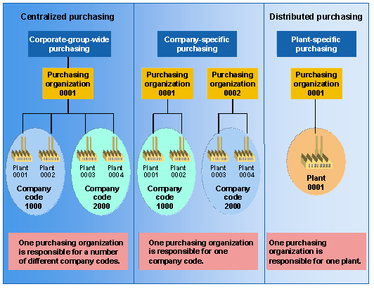
SAP MM Overview

Slide 10
SAP MM Overview
Purchase Group
A Purchasing Group represents an individual or a group of individuals.
This is usually used for reporting purposes, as well as approval procedure (release strategy) for Purchase Requisitions (PR), Requests for Quotation (RFQs), Purchase Orders (PO), Contracts, etc..

Slide 11
SAP MM Overview
Enterprise Structure Configuration
Define Company | OX15
Define Company code | OX02
Define Plant | OX10
Maintain Storage Location | OX09
Define Purchasing Organization | OX08
Assign Plant to Company Code | OX18
Assign Purchasing Organization to Plant | OX17
Assign Purchasing Organization to company code | OX01
Create Purchasing Groups | OME4
Define Valuation Level | OMSK

Slide 12
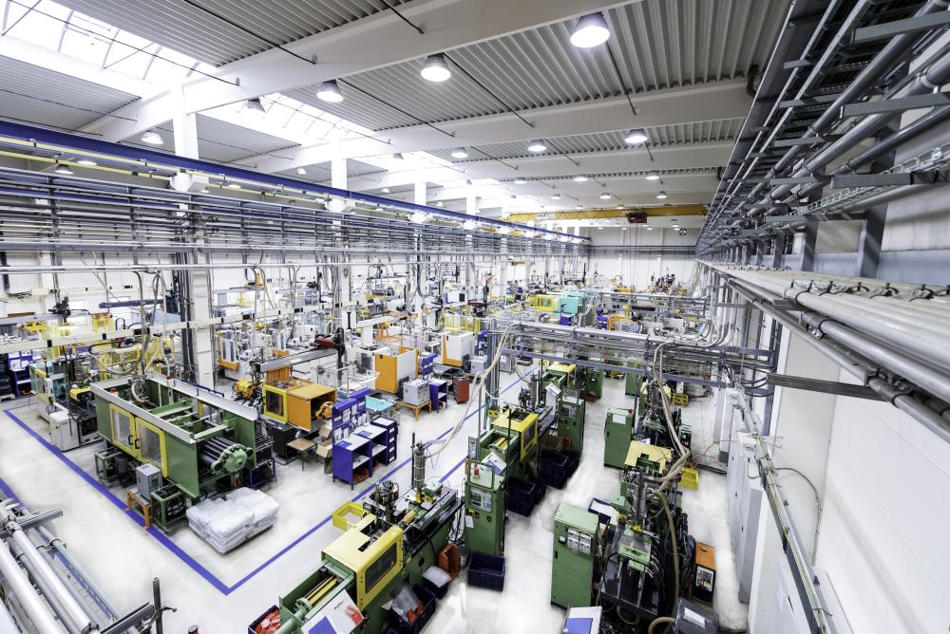
SAP MM Overview
Material management
Planning
Purchasing
Inventory Management

Slide 13
SAP MM Overview
Planning
What is needed
How much is needed
When is needed
helps companies maintain appropriate levels of inventory so that business can better align their products with rising and falling demand.

Slide 14
SAP MM Overview
Purchasing
Notes:
Company-In an organizational unit represents the enterprise structure.
Business Residence- Geographical location which legally belongs.
Segment- Financial reporting purpose.
Reporting line- Approval from hierarchy level in a company
Profit center- Responsible for generating revenues. For example, Sales department.
Cost center- Individual costs incurred during a given period. For example, consider a company's legal department, accounting department, research and development, advertising, marketing, and customer service a cost center.
Functional Area- Particular functions should be enabled (ie) activities like sales and service, purchasing, supply chain management, finance, human resource and administration.

Slide 15
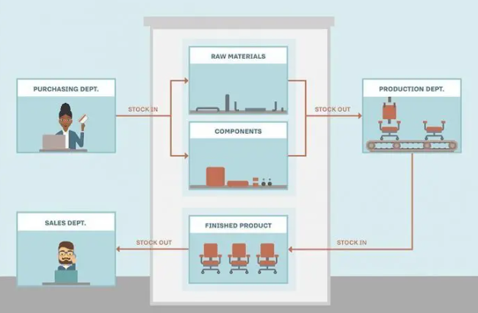
SAP MM Overview
Inventory Management
Notes:
Company-In an organizational unit represents the enterprise structure.
Business Residence- Geographical location which legally belongs.
Segment- Financial reporting purpose.
Reporting line- Approval from hierarchy level in a company
Profit center- Responsible for generating revenues. For example, Sales department.
Cost center- Individual costs incurred during a given period. For example, consider a company's legal department, accounting department, research and development, advertising, marketing, and customer service a cost center.
Functional Area- Particular functions should be enabled (ie) activities like sales and service, purchasing, supply chain management, finance, human resource and administration.

Slide 16
SAP MM Overview
Inventory Management
Inventory Management is a part of a Material Management module. - Inventory management means managing the material stock or material movements. - Inventory management works on two ways
On Qty updating (at store location) b) On Value updating (at A/c)
Inventory Management is fully integrated with PP, SD, QM, FI/CO
Goods movement
There will be a transaction resulting in a change in stock. Types of Goods movement:
• Goods Receipt (GR)
• Good Issue (GI)
• Stock Transfer
• Transfer posting
Notes:
Company-In an organizational unit represents the enterprise structure.
Business Residence- Geographical location which legally belongs.
Segment- Financial reporting purpose.
Reporting line- Approval from hierarchy level in a company
Profit center- Responsible for generating revenues. For example, Sales department.
Cost center- Individual costs incurred during a given period. For example, consider a company's legal department, accounting department, research and development, advertising, marketing, and customer service a cost center.
Functional Area- Particular functions should be enabled (ie) activities like sales and service, purchasing, supply chain management, finance, human resource and administration.

Slide 17
SAP MM Overview
Inventory Management
Goods Receipt (GR)
It is a goods movement from vendor or production.
A good receipt leads to an increase in warehouse stock
Goods Issue (GI)
It is also a good movement, with this Material Issue production
Material consumption
Shipment of goods to a customer - is posted
A goods issue leads to a reduction in warehouse stock
Notes:
Company-In an organizational unit represents the enterprise structure.
Business Residence- Geographical location which legally belongs.
Segment- Financial reporting purpose.
Reporting line- Approval from hierarchy level in a company
Profit center- Responsible for generating revenues. For example, Sales department.
Cost center- Individual costs incurred during a given period. For example, consider a company's legal department, accounting department, research and development, advertising, marketing, and customer service a cost center.
Functional Area- Particular functions should be enabled (ie) activities like sales and service, purchasing, supply chain management, finance, human resource and administration.

Slide 18
SAP MM Overview
Inventory Management
Stock Transfer:
It is also one more goods movement - It means removal of material
Storage location to Storage location (Within a Plant)
Plant to Plant (Within a Company)
Company to Company
Transfer Posting:
It is a general term for changes in stock type or stock category or stock status of a material
Transfer posting from material to material
Release from quality inspection stock
[Note: It is irrelevant whether the posting occurs in connection with physical movement or not]
Result of Goods movement - A Material document is created
Notes:
Company-In an organizational unit represents the enterprise structure.
Business Residence- Geographical location which legally belongs.
Segment- Financial reporting purpose.
Reporting line- Approval from hierarchy level in a company
Profit center- Responsible for generating revenues. For example, Sales department.
Cost center- Individual costs incurred during a given period. For example, consider a company's legal department, accounting department, research and development, advertising, marketing, and customer service a cost center.
Functional Area- Particular functions should be enabled (ie) activities like sales and service, purchasing, supply chain management, finance, human resource and administration.

Slide 19
SAP MM Overview
MM Master Data
Material master records
Service master records
Vendor master records
Purchase info records
Source list records
Quota arrangement records

Slide 20
SAP MM Overview
Material Master
In SAP MM modules, material master data refer to all the material master records, which are stored in SAP system.
The material master is the central source of information for a material related to several application area (Purchasing, storage, accounting, sales, etc) based on material type
In SAP MM, material master data is maintained at plant level and accounting information is maintained at valuation area level.
The valuation are is an organization level at which material are valuated. The valuation are can be a plant or a company code.

Slide 21
SAP MM Overview
Material Master Record Maintenance
Initial Level
Main work level → Individual user department screens
Additional data level → Additional information (Consumption, unit of measure)
Material Master Record at Org level
Data at Client level → General material data valid for entire company
Data at Plant level → Data Valid within which plant and storage location level is stored
Data at Storage level → Data valid within only which storage location level is stored.

Slide 22
SAP MM Overview
Material Type
In SAP MM, material types are the materials which are having the similar attributes are categorized together and assigned to a material type. It is a classification of allowed material into material types based on attributes.
In material master, material type controls the following functions
Number range assignments i.e. External or Internally.
Field selections i.e. which fields are mandatory, optional, hide and display.
Quantity and values basis
External procurement or internal procurement
Which value classes are to be allowed

Slide 23
SAP MM Overview
Industry Sector determines
Screen Selection
Field Selection

Slide 24
SAP MM Overview
Material Group
Material groups are defined at client level, you can define material groups in SAP to differentiate the various materials. For example, an electronic manufacturing organization can classify computers as desktops, televisions as electronics, speakers as sound systems, etc. Each classification have its own individual group.
“Material which are having same characteristics are grouped together and assign to a material group in SAP. It is not a control function like material type, where the material groups are used to generate the reports

Slide 25
SAP MM Overview
Material Master Configuration & Creation
Define Attributes of Material Types | OMS2
Define Material Number Format | OMSL
Define Number Ranges for Material Type | MMNR
Assign Number Range Group to Material Type | MMNR
Define Industry Sectors | OMS3
Define Material groups | OMSF
Define Unit of Measures | CUNNI
Material Master Creation | MM01
Material Master Extend or Change | MM02
Material Master Creation | MM03

Slide 26
SAP MM Overview
Material Master T.codes
MM01 → Create & Extension
MM02 → Change
MM03 → Display
MM04 → Active Changes
MM17 → Mass Maintenance
MMAM → Material type change
MMBE → Stock Overview
MMPV → Close Period
MMRV → Allow Posting to Previous Period
MM50 → Extend Material View(s)
MMSC → Enter Storage Locations
MM60 → Materials List

Slide 27
SAP MM Overview
Vendor Master
Vendor master data is a complete record of the supplier's relevant information. As such, it should capture everything from procurement history to information about the goods and services sourced from the vendor, inventory data, contract records, purchasing records.
Vendor account group
The Intervals for the number assignment.
Status of Vendor or one-time account
Field Selection.
Vendor sub range and plant specific data.
Partner function
Note: An Account Group must be assigned to each Vendor master record.

Slide 28
SAP MM Overview
Vendor Configuration
Define Account Groups with Screen Layout (Vendors) | OBD3
Create Number Ranges for Vendor Accounts | XK01
Assign Number Ranges to Vendor Account Groups | Nil

Slide 29
SAP MM Overview
Types of Vendors:
Internal Vendors → Supplying by another company code under the same client
External Vendors → A Material supplies from outside vendor.
Regular Vendors → A vendor supplies the material at client level (Entire corporate group).
Fixed Vendor → The Company will take certain materials from vendor, which are low
Value and high volume type.
One time Vendors → Supply only once. (Enter the vendor data manually)

Slide 30
SAP MM Overview
Categories of Vendor Master Record
1. General Data (3 screens) → Address, Communication & Contact person
Control data and vendor bank details.
2. Company code data (4 screens) → Account management (reconciliation a/c etc.)
Payment transaction (payment methods).
Correspondence and Withhold tax.
3. Purchasing Org. data (2 screens) → Purchasing data and Partner roles.

Slide 31
SAP MM Overview
PURCHASE INFO RECORDS
The Purchasing Info Records (PIR) is an association of material and vendor. Therefore, it is used for source of supply determination in purchasing.
Two kinds of PIRs exist: with and without purchasing organization data.
Maintained Info Record
PIR is apply to All Plant or Single Plant of Purchase organization level
PIR general data is maintained at Client level
PIR purchasing data is maintained at Purchasing level
PIR purchasing data is maintained at Purchasing/plant level

Slide 32
SAP MM Overview
Special Function in Info Record (MEKP)
Gross Price
Condition Type
PIR Created via
Manually → ME11
Automatically (Via Info Record Update indicator)
Quotation → ME41
Outline Agreement → ME31K & ME31L
Purchase Order → ME21N

Slide 33



Purchasing info records
Piece
%
Conditions
USD
Info record
Material
Vendor A
Info record
Stock material M1
Info record
Consumable material M2
Info record
Vendor B
Info record
Service S1

Slide 34
Data in the purchasing info record
General data
Texts
Vendor data Origin data Order unit
Control data
Delivery time Minimum quantity Tolerances
Prices and conditions
Gross price Discounts Freight
Price history Purchasing statistics Changes

Slide 35
SAP MM Overview
SOURCE LIST RECORDS
Source Determination:
The source determination process tries to assign a source of supply to purchase requisition items.
When creating a purchase requisition, if select the Source Determination indicator checkbox, the system searches for possible sources of supply and list out the valid sources of supply for an item.
Source Determination: Available in following functions
Creating Purchase Requisition → ME51N
Assign Purchase Requisition → ME56
Assign & Process Purchase Requisition → ME57
Create Pur. Order Unknown Vendor → ME25
Convert Planned Order to Pur Order → MD14 or MD15

Slide 36
SAP MM Overview
Source List Function
Defining a source as a fixed source
Blocking a source
Defining a source as relevant in a planning run
Supplementing source determination when using a quota arrangement
Source List Created via
Manually → ME01
Outline Agreement → ME31K & ME31L
Info Record → ME11
Automatically → ME05

Slide 37


Source list
1.1.95 - 30.6.95
1.7.95 - 31.12.95
Source list
Vendor 1 allowed Vendor 2 allowed Vendor 3 allowed
Vendor 1
fixed
Material M1
Plant 0001

Slide 38
SAP MM Overview
QUOTA ARRANGEMENT RECORDS
A quota arrangement represents an additional source assignment option in the process of automatic source determination. If a quota arrangement exists for a material, it has the highest priority during source determination.
Quota arrangement Maintained table Name → EQUP (Purchasing Related)
Quota Arrangement is maintained at manually → MEQ1
Quota arrangement usage
Purchase Requisition
Purchase Order
Production order
SA Scheduling Lines
MRP
Planned order

Slide 39
SAP MM Overview
QUOTA ARRANGEMENT RECORDS
A quota arrangement represents an additional source assignment option in the process of automatic source determination. If a quota arrangement exists for a material, it has the highest priority during source determination.
Quota arrangement Maintained table Name → EQUP (Purchasing Related)
Quota Arrangement is maintained at manually → MEQ1
Quota arrangement usage
Purchase Requisition
Purchase Order
Production order
SA Scheduling Lines
MRP
Planned order

Slide 40
SAP MM Overview
Procurement Types
Normal Procurement
Special Procurement
Stock transfer with stock transport orders
Subcontracting
Vendor consignment
Pipeline

Slide 41
SAP MM Overview
Stock transfer with stock transport orders

Slide 42
SAP MM Overview
Stock transfer with stock transport orders
Purchasing creates a stock transport order for the receiving plant.
The supplying plant enters a goods issue that references the stock transport order. After this posting, the quantity is managed in special stock (stock in transit) of the receiving plant.
The goods receipt in the receiving plant is posted with reference to the stock transport order.
The quantity is transferred from stock in transit to the storage location stock of the receiving plant.

Slide 43
SAP MM Overview
Subcontracting

Slide 44
SAP MM Overview
Subcontracting
The product is ordered with a subcontract purchase order that contains details about the material to be delivered and the components to be made available to the subcontractor.
Components are provided to the subcontractor. This provision is mapped in the system by transfer posting. Although the components that have been provided are no longer physically in your company, they are managed in your stocks because they still belong to you. The information is shown under the special stock type, Stock of material provided to vendor.
The finished or refined material is delivered by the subcontractor. The goods receipt is entered with reference to the (subcontract) order. When posting the goods receipt of the final product, the consumption of the components from the stock of material provided by the vendor is also posted.
Finally, the subcontractor raises an invoice for the service rendered.

Slide 45
SAP MM Overview
Supplier Consignment

Slide 46
SAP MM Overview
Supplier Consignment
Request the material from your vendor using a consignment order.
Post the goods receipt with reference to the consignment order when the material is delivered. The quantity of the material is managed in a special stock, the consignment stock. This completes the procurement process because payment is required for the material after withdrawal, not after supply.
When a goods issue is posted from the consignment stock, a liability arises for the supplier.
The SAP system provides a special function for settling consignment liabilities. The program creates a credit memo with an appropriate message for the supplier.

Slide 47
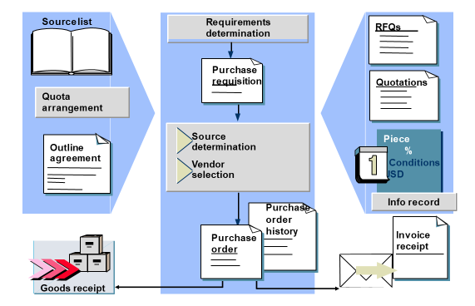
SAP MM Overview
External Procurement

Slide 48
SAP MM Overview
Structure of Purchase Order

Slide 49
SAP MM Overview
Item Categories in Purchase Order

Slide 50
SAP MM Overview
Item Categories in Purchase Order
Standard: Materials that are to be procured externally (account assignment possible; material number mandatory if no account assignment; GR (good receipt) and IR (invoice receipt) possible).
Limit: You procure consumable materials or services with a value limit (Material number not possible; account
assignment mandatory, but account assignment category ”Unknown” possible; GR not possible; IR mandatory).
Consignment: The material belongs to the vendor until it is withdrawn. (material number mandatory; non-valuated GR mandatory; account assignment and IR notpossible).
Subcontracting: The finished product is ordered from a vendor. (material number and account assignment possible;
specification of the components to be provided required; GR required; IR possible).
Stock transport orders: The material is transferred from one plant to another (material number mandatory; GR
mandatory; IR not possible).
Third-party order: The vendor is to deliver the ordered material directly to a third party (a customer, for example).

Slide 51


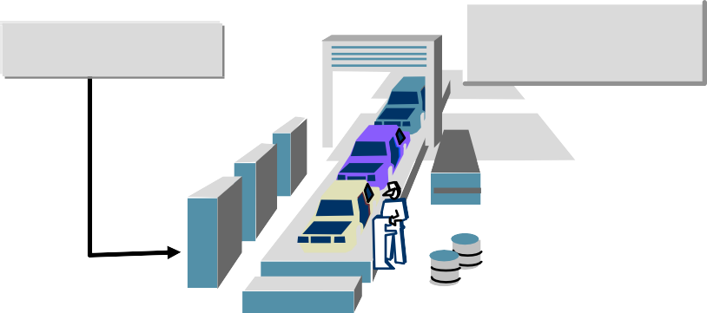

SAP MM Overview
Procurement for Stock Material
Purchasing document(s)
Item:
no account assignment category
Warehouse
Goods receipt
Goods issue
Material
Production
Vendor

Slide 52


SAP MM Overview
Procurement for Consumption
Purchasing document(s)
Item:
with account assignment category
Goods receipt
Production
Vendor
Material

Slide 53
SAP MM Overview
Stock Vs Consumable Material

Slide 54
SAP MM Overview
MRP Planning for Stock Materials
Requirements planning
Net requirements calc.
Forecasting
Lot sizing
A
Material
Scheduling
Material master
Inventory management
Purchasing

Slide 55
SAP MM Overview
MRP Planning for Stock Materials
The SAP MRP (Material Requirement Planning) is used to procure or produce the required material quantities on time for in-house purpose or for fulfilling customer demands. In manufacturing, the function of MRP is to guarantee material availability on time. The main objective is to plan the supply based on requirements and considering the current stock in hand and meet the shortages.
MRP Types can be categorized in to 2 major categories,
Material Requirement planning
consumption-based planning

Slide 56

SAP MM Overview
Reorder Point Procedure
Stock
Lot size
Reorder level
Safety stock
Reorder point Delivery date
Replenishment lead time
Time

Slide 57
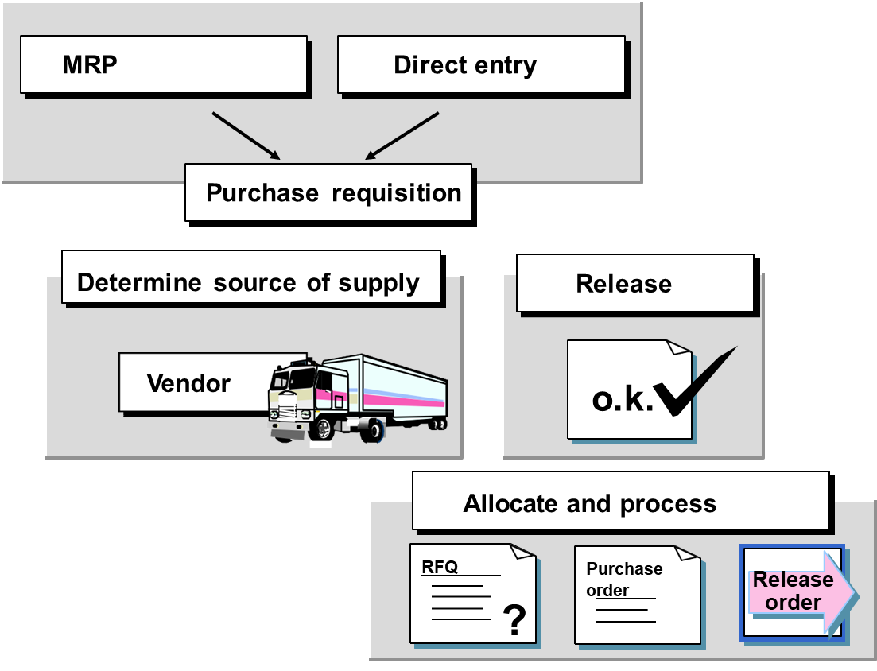
SAP MM Overview
Purchase requisition processing

Slide 58
SAP MM Overview
Purchase requisition processing
A purchase requisition is a request that is made to the purchasing organization to procure a certain list of materials.
It is an internal document and remains within the organization.
Purchase requisition needs approval from the purchasing organization.
If a purchase requisition has already been approved, then it can be modified only to a limited extent.
Purchase requisition can be created for the following procurement types −
Standard − Getting finished material from vendor.
Subcontracting − Providing raw material to vendor and getting finished material.
Consignment − Procuring material that is kept in company’s premises and paying to vendor for that.
Stock transfer − Getting material from within the organization.
External service − Getting services like maintenance from third party vendor

Slide 59
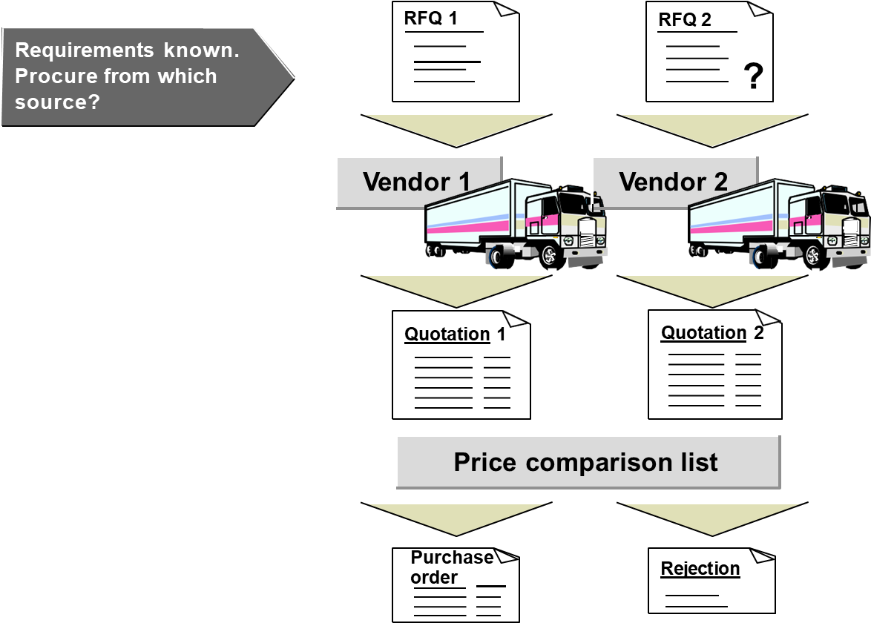
SAP MM Overview
Request for quotation/ quotation

Slide 60
SAP MM Overview
Request for quotation/ quotation
Request for quotation is a form of invitation that is sent to the vendors to submit a quotation indicating their pricing and terms and conditions.
It contains details about goods or services, quantity, date of delivery, and date of bid on which it is to be submitted.
Quotation is a reply by a vendor in response to a request for quotation.
An RFQ can be created by the following two ways −
Manually
Automatically from Purchase Requisition

Slide 61
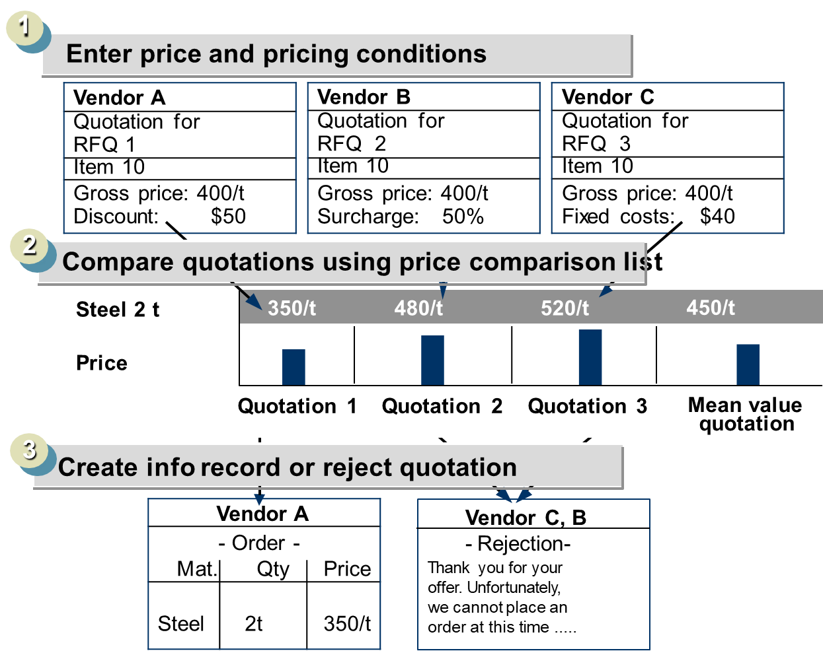
SAP MM Overview
Processing Quotations

Slide 62
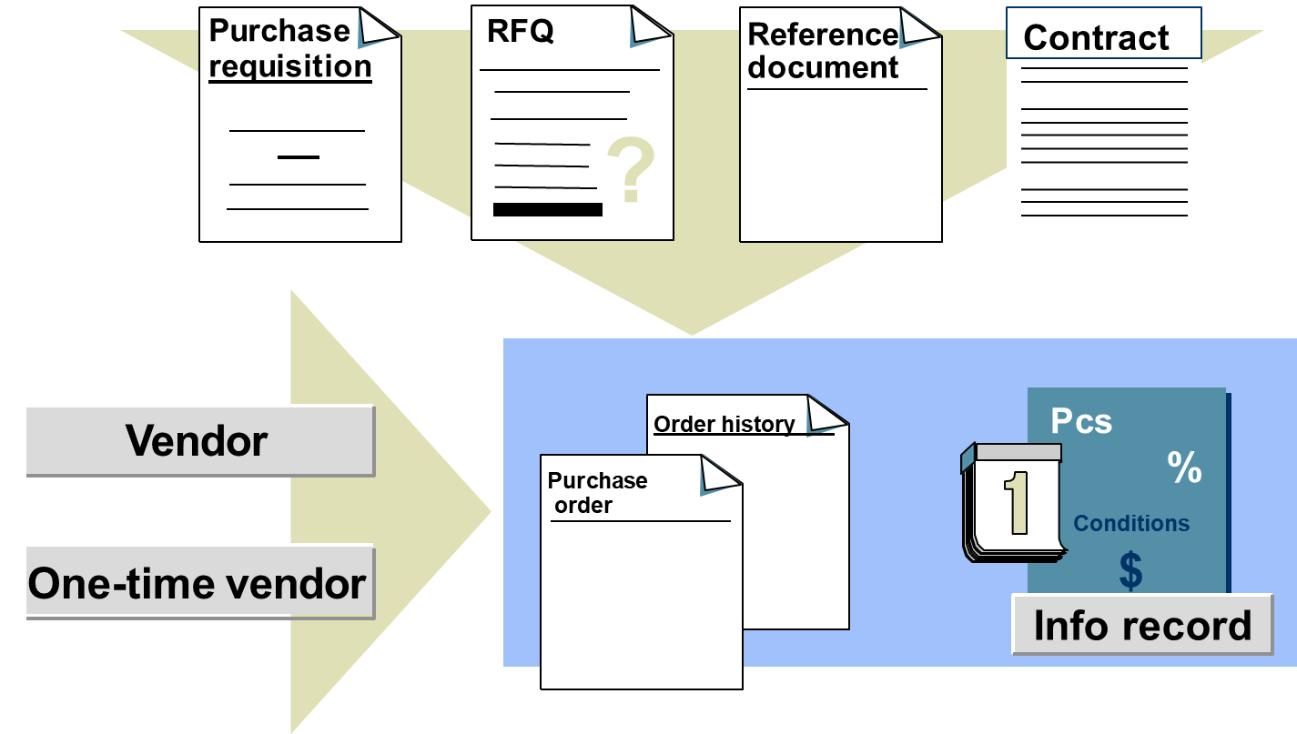
SAP MM Overview
Processing Purchase Orders

Slide 63
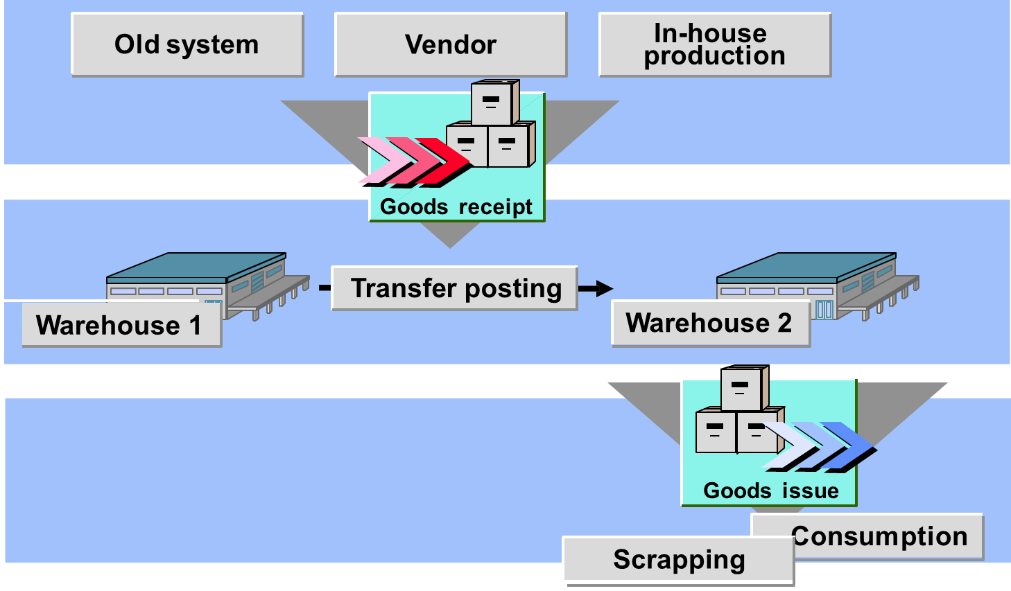
SAP MM Overview
Inventory management

Slide 64
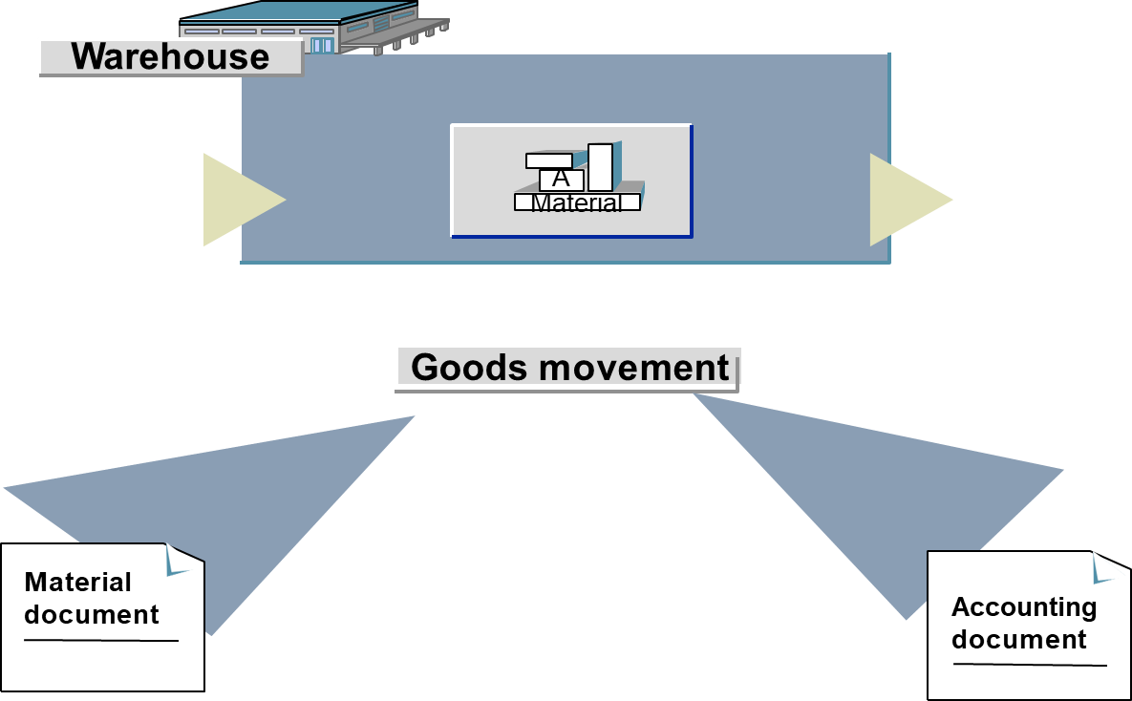
SAP MM Overview
Documents for goods movements

Slide 65
SAP MM Overview
Inventory management
Inventory management deals with the management of stock, either on value or quantity basis.
It includes planning, entry, and keeping records of all the movements of goods.
Goods movement creates a document that updates all the stock quantity and value in the inventory that is known as the material document.
A material document is referred by a document number and document year.
One normally comes across the following terms while doing inventory management −
Movement Type
Goods Receipt
Reservation
Goods Issue

Slide 66
SAP MM Overview
Posting procedure for goods receipt
Stock account Stock value
GR/IR clearing
Price differences
( ) ( )
Update for goods receipt

Slide 67
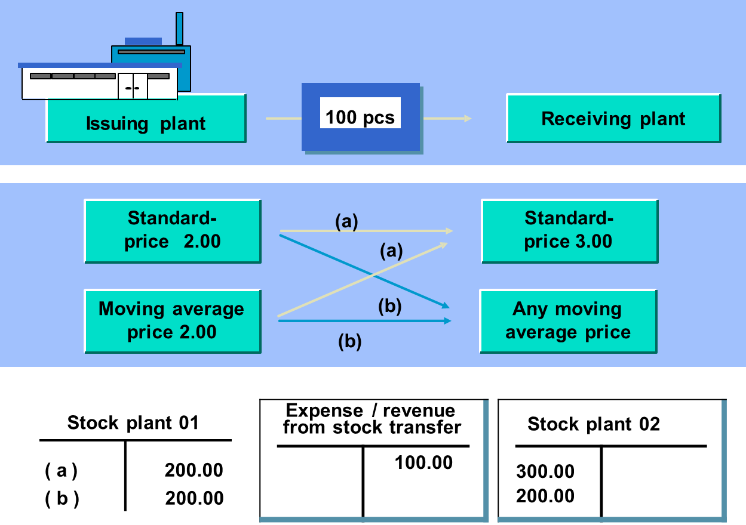
SAP MM Overview
Valuation in the Case of Stock Transfer

Slide 68
SAP MM Overview
Physical Inventory
Physical inventory is a process of determining that the inventory quantities are exact, or if there are differences in quantity mentioned physically present and that mentioned in the SAP system.
Periodic inventory
Continuous inventory
Cycle counting
Inventory sampling

Slide 69
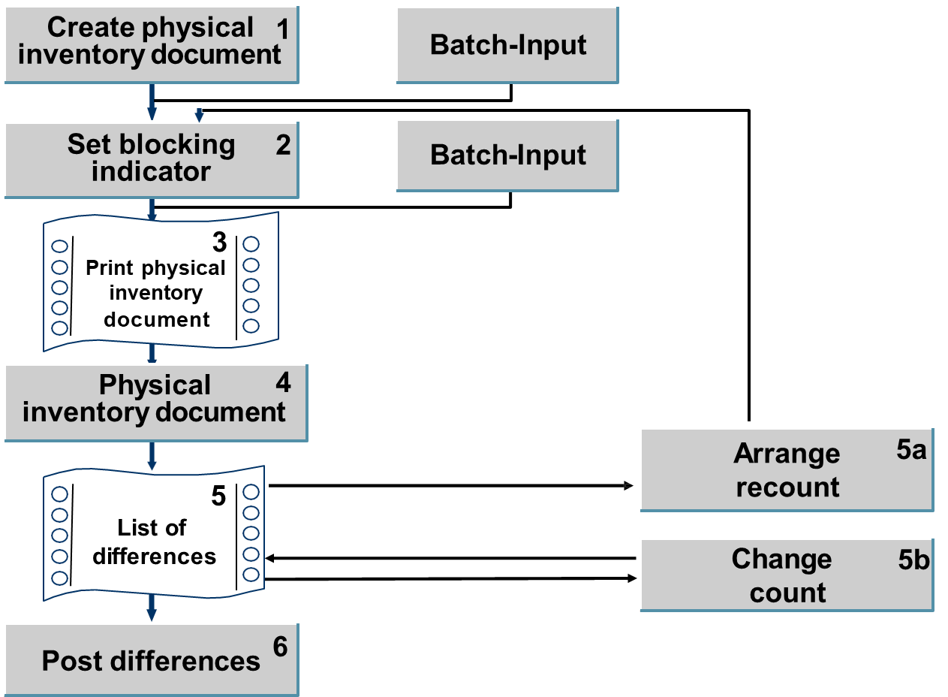
SAP MM Overview
Physical inventory procedure

Slide 70
SAP MM Overview
Physical Count

Slide 71
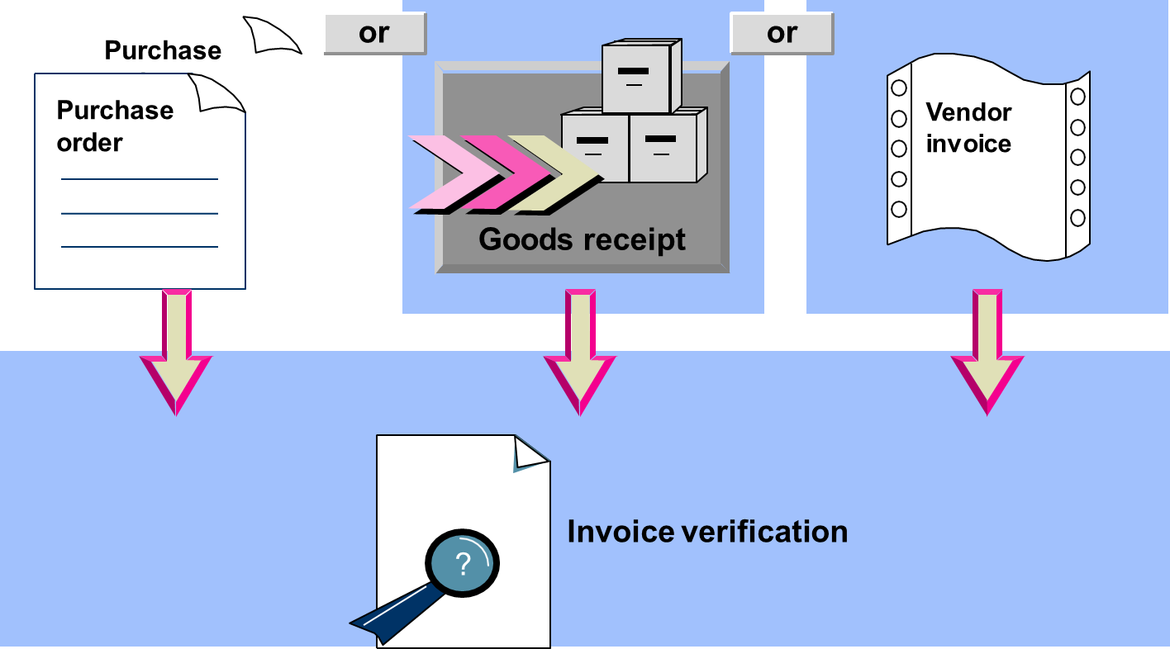
SAP MM Overview
Types of invoice verification

Slide 72
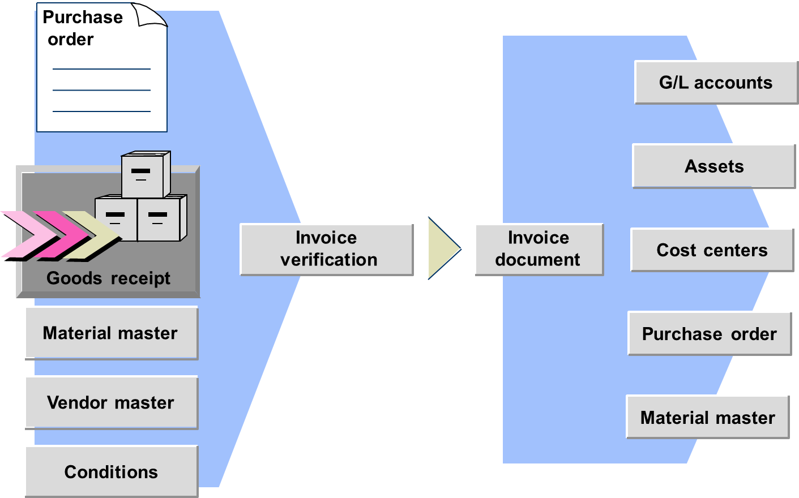
SAP MM Overview
Invoice verification environment

Slide 73
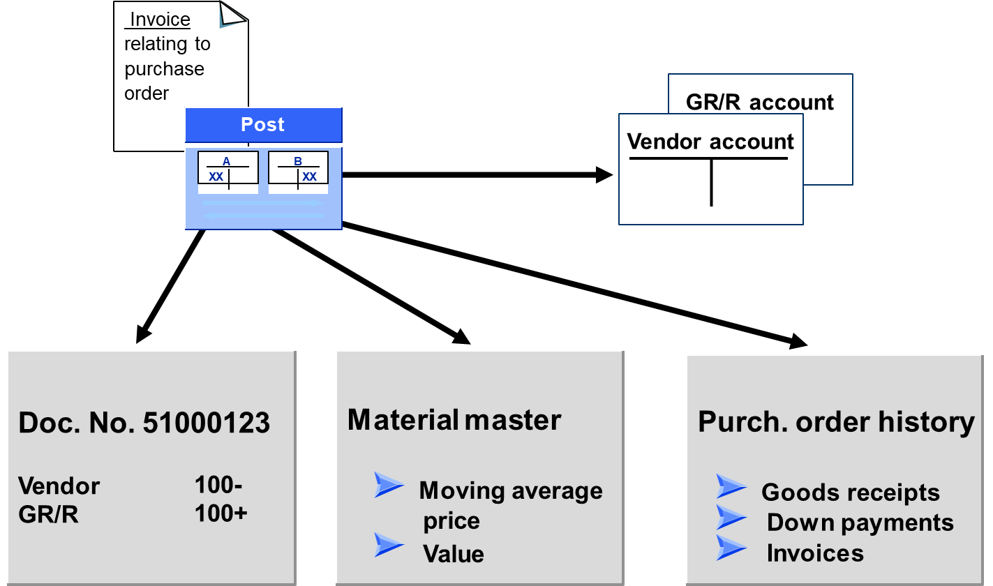
SAP MM Overview
Posting an invoice

Slide 74
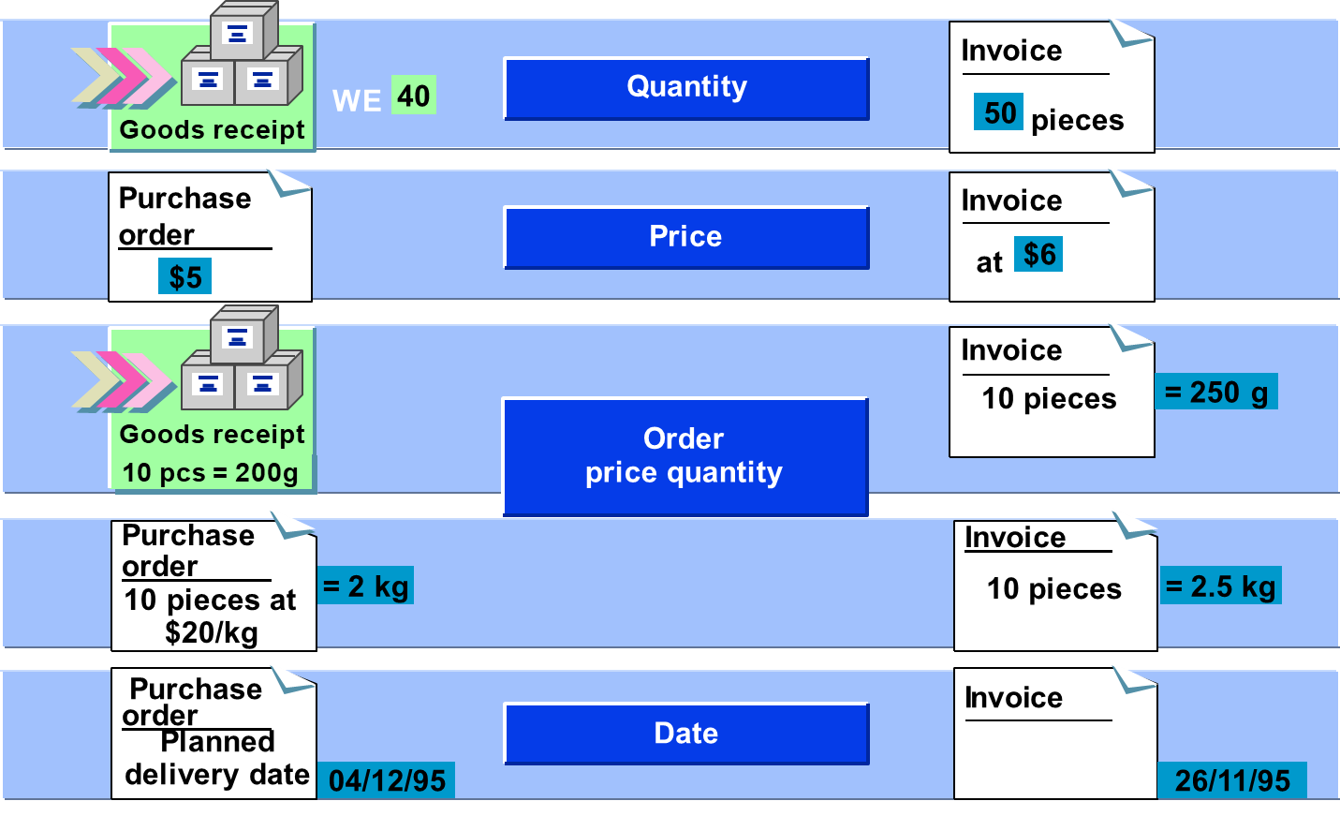
SAP MM Overview
Variances

Slide 75
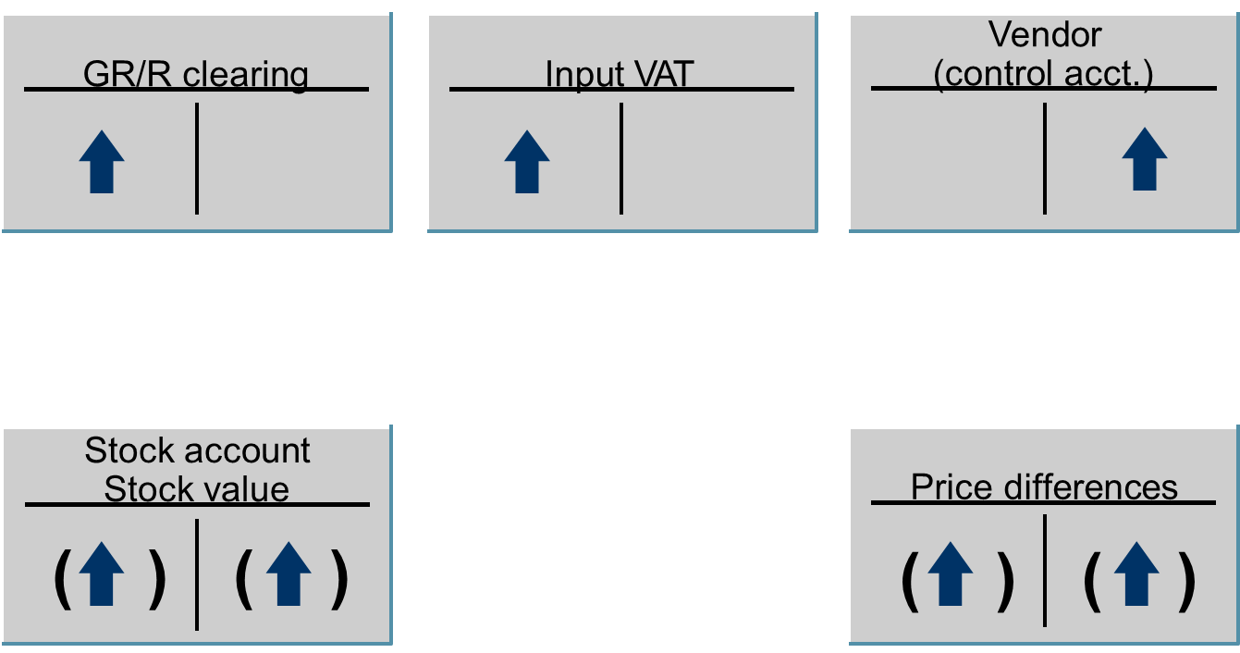
SAP MM Overview
Invoice receipt postings

Slide 76
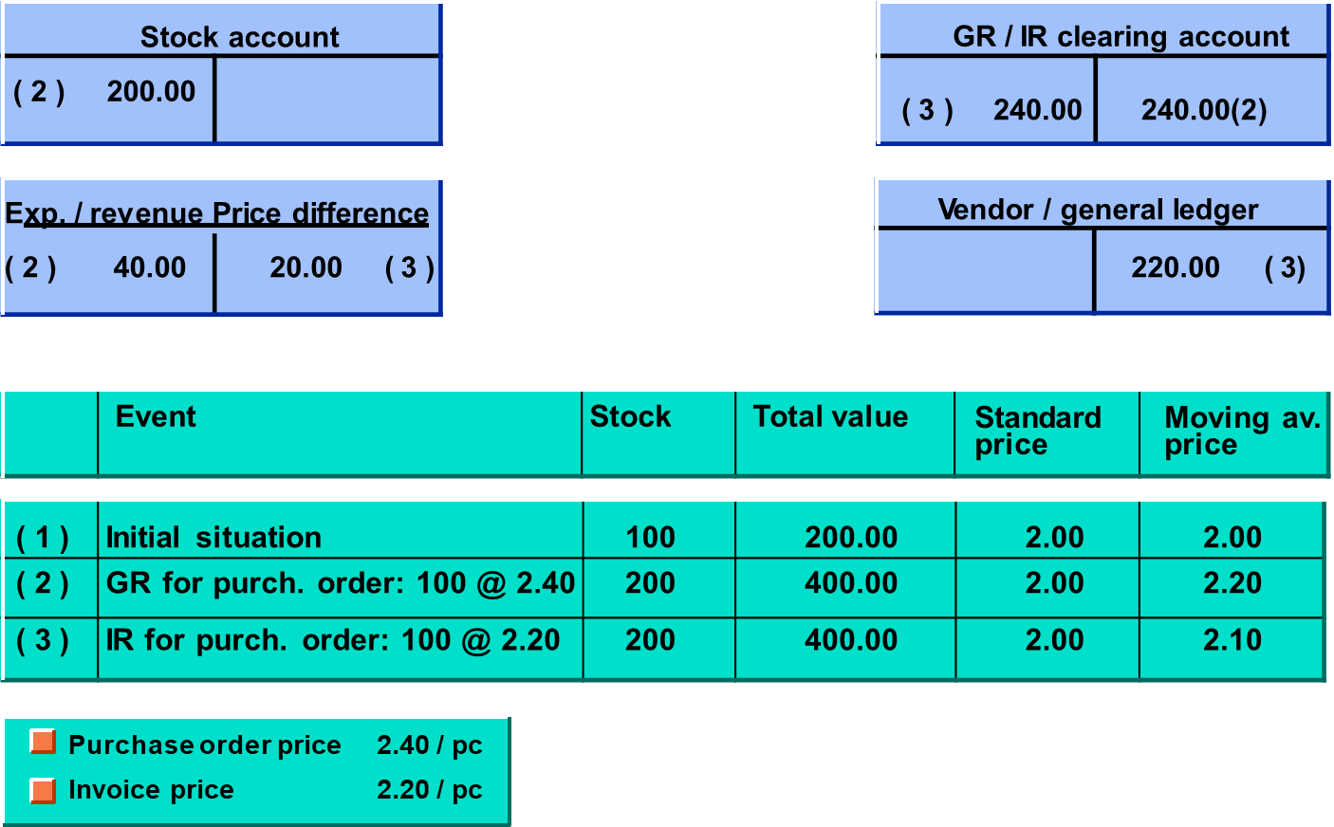
SAP MM Overview
Postings at Standard Price

Slide 77
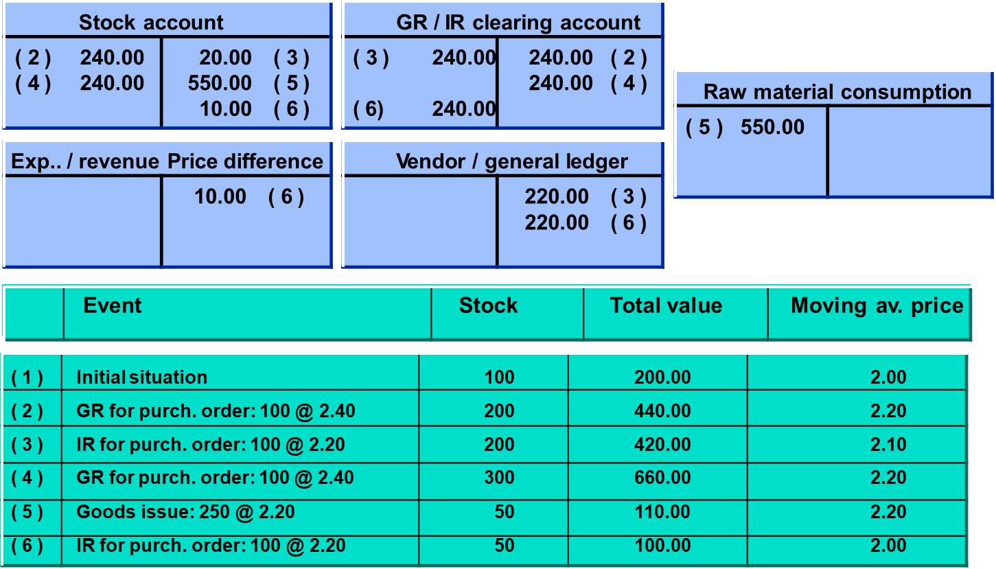
SAP MM Overview
Postings at Moving Average Price

Slide 78
SAP MM Overview
INVOICING PLANS
Facility to schedule Invoicing dates for planned procurement independent of goods and service receipts
Periodic Invoicing Plan
Partial Invoicing Plan

